Slide 1
Welcome Justice & Equity Coalition July 27, 2022

Slide 2
Learn to do good; seek justice, correct oppression.

Slide 3
Agenda HOUSING CRISIS IN WYANDOTTE COUNTY
Welcome
Videos
Special Guest
Speakers: Candidates, Community Housing Improvement Plan (CHIPS)
-
Discussions, comments,

Slide 5
https://wearewyandotte.com/#thereporthome
https://wearewyandotte.com/#thereporthome

Slide 6
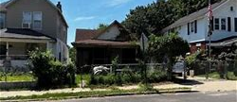
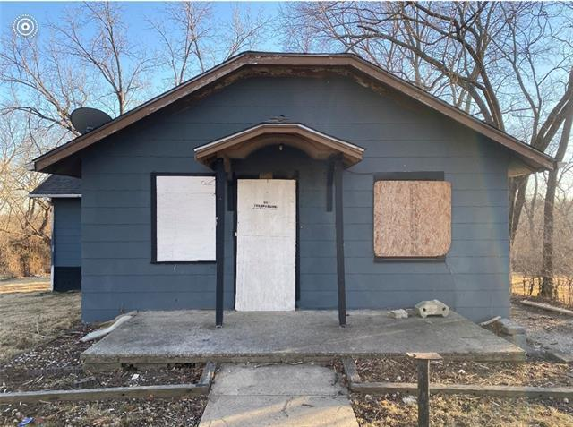
Deryl Wynn

Slide 8
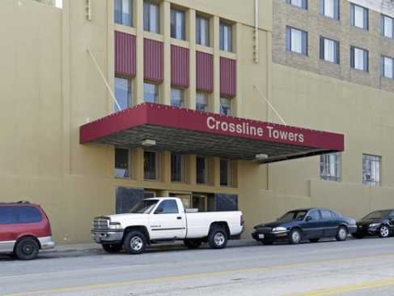
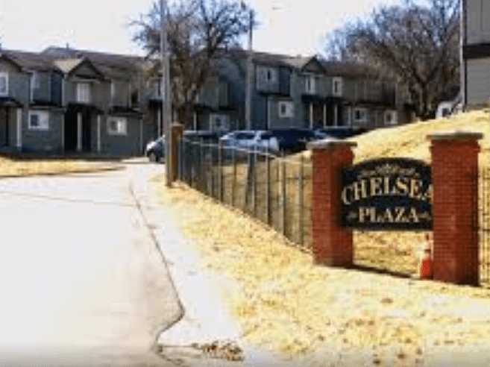
Speakers: Community Health Improvement Plan Rod Santel - Crosslines Comm. Outreach Susan Caman Unified Government of Wyco

Slide 9
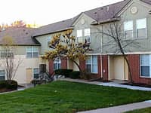
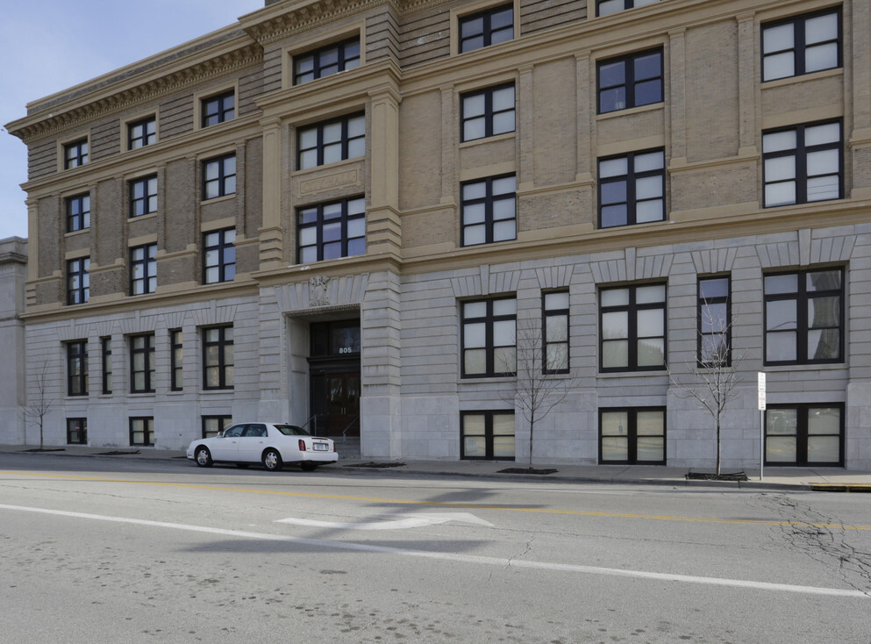
Affordable Housing Crises In Wyandotte County?
STATISTICS
1. 843 ON THE public housing wait list
2. $1,363.52 Average monthly wage = $8.52 a hour
3. $1,030.00 average cost for 2 BED ROOM unit

Slide 10
What Can We Do?
Stay Tuned
Next month join us for more information on the affordable housing crisis and what we as a community can do.

