Slide 1
Justice and Equity Coalition Meeting September 28, 2022
It is not good to be partial to the wicked and so deprive the innocent of justice. Proverbs 18:5

Slide 2
Suicide Rates in Kansas
Kansas is ranked 17th in the nation for its high suicide rate. Throughout the state of Kansas, suicide is the:
2nd leading cause of death for ages 10-44
5th leading cause of death for ages 45-54
8th leading cause of death for ages 55-64
17th leading cause of death for ages 65+
Overall, suicide is the 10th leading cause of death in Kansas.
More than 5 times as many people died by suicide in 2019 than in alcohol-related motor vehicle accidents.
67.9% of communities did not have enough mental health providers to serve residents in 2020, according to federal guidelines.
WELCOME

Slide 3
Agenda
Welcome
Short Videos -
Discussion – Facilitator Deryl Wynn
Public Policy and Advocacy Committee
Victim Rights Committee
Education and Awareness Committee
Youth and Prevention Committee

Slide 6
Deryl Wynn Facilitator
This Photo by Unknown Author is licensed under CC BY-NC-ND

Slide 7
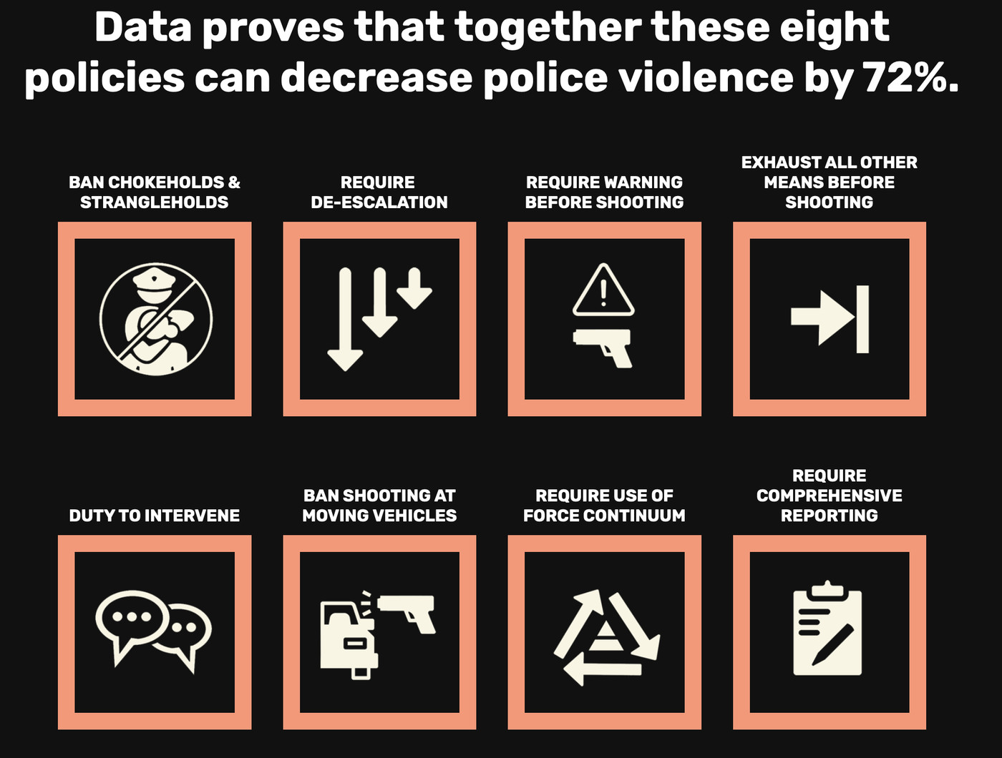
Public Policy Committee
This Photo by Unknown Author is licensed under CC BY-ND

Slide 8
Youth and Prevention Committee
Updates
and
Challenges

Slide 9
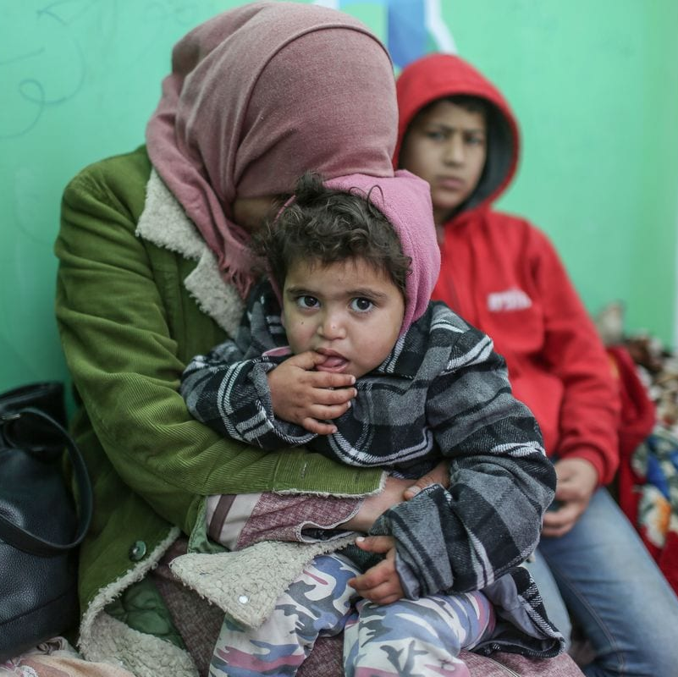
Victim Rights Committee Report
BPU Bills
Warming Center 2022-2023
Housing
This Photo by Unknown Author is licensed under CC BY-SA-NC

Slide 10
Education and Awareness Committee
Who is our target audience?
How do we get information to the audience?
Website?
Newsletters?
Social Media?
This Photo by Unknown Author is licensed under CC BY-SA

